Slide 1
Overview of Microsoft Role-Based Certification in 2020
Azure in the ATL
January 21, 2020

Slide 2
Agenda
Why Certification?
Microsoft Role-Based Certification
Azure Roles and Certifications
Understanding Test Scope
Learning Resources
Demos
Q and A

Slide 3
About Me
Eric Flamm, Flamm Consulting Inc.
BI / Data Engineering Consultant since 2000
Corporate experience in Engineering, Finance, and IT
Focus on Microsoft Data Platform
Active volunteer with local user groups and Boy Scouts
Past presentations include SQL Saturday (Atlanta, Chicago, Virginia Beach), Global Azure Boot Camp, Azure Datafest ATL, and local user groups
Disclaimer: I am NOT a Microsoft employee and do NOT have an NDA for training/certification. All content is publicly available and subject to change without me knowing anything about it.

Slide 4
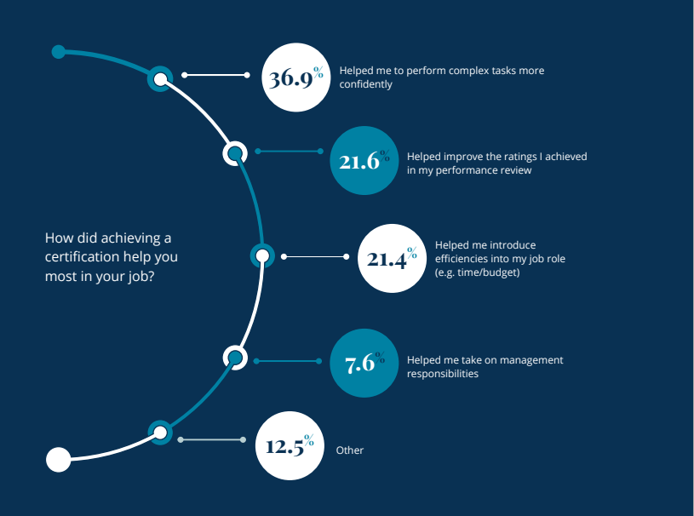
Why Certification?
Pearson VUE 2017 Value of IT Certification Survey
Better Performance
Better Reviews
Increase Efficiency
Promotability

Slide 5
Microsoft Role-Based Certification
Focus on skills and concepts needed for specific job roles
Training driven by working professionals with role-specific experience
4 “Solution Spaces” to group related roles:
Apps and Infrastructure
Data and AI
Modern Workplace (Microsoft 365)
Business Applications (Power Platform and Dynamics)
4 Fundamentals Exams aligned with Solution Spaces:
AZ-900 (Azure Fundamentals) – Apps and Infrastructure AND Data and AI
MS-900 (MS 365 Fundamentals) – Modern Workplace
PL-900 (Power Platform Fund) and MB-900 (Dynamics Fund) – Bus Applications

Slide 6
Microsoft Role-Based Certification
In addition to Fundamentals exams, there are 3 exam levels:
Associate – leading to MS Associate certification
Expert – leading to MS Expert certification
Specialty – standalone certifications for niche area (e.g., SAP Admin)
Azure is the underlying platform for Apps and Infrastructure and Data and AI Solutions

Slide 7
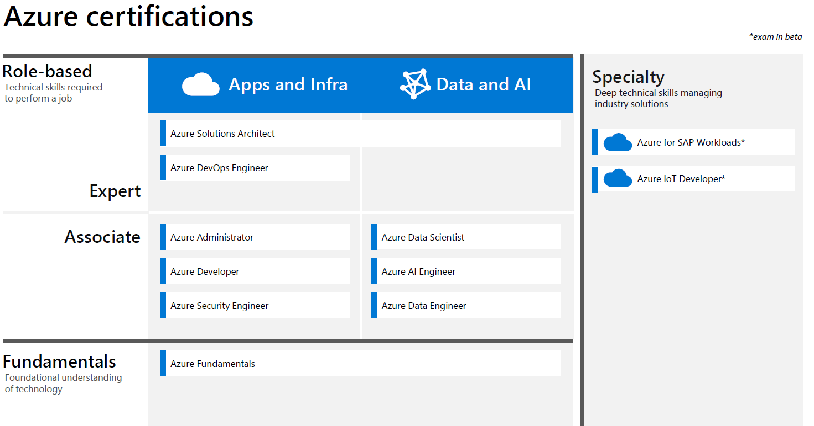
Azure Roles and Certifications

Slide 8
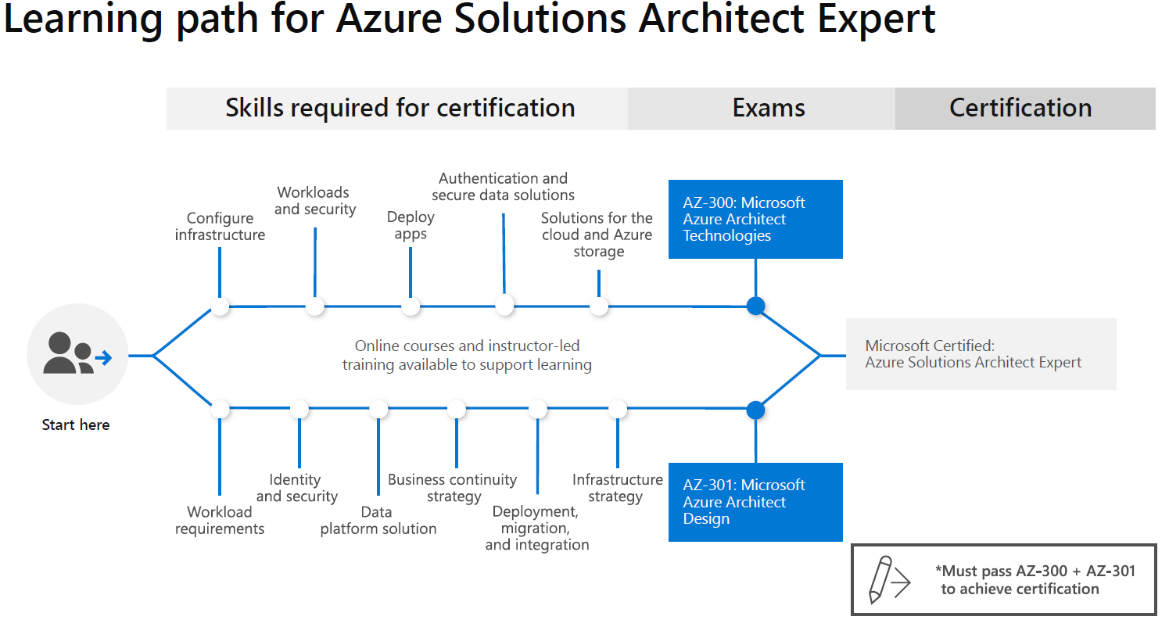
Understanding Test Scope
For each certification, there is a “learning path”, which highlights the broad concept areas covered in each exam required for the certification

Slide 9
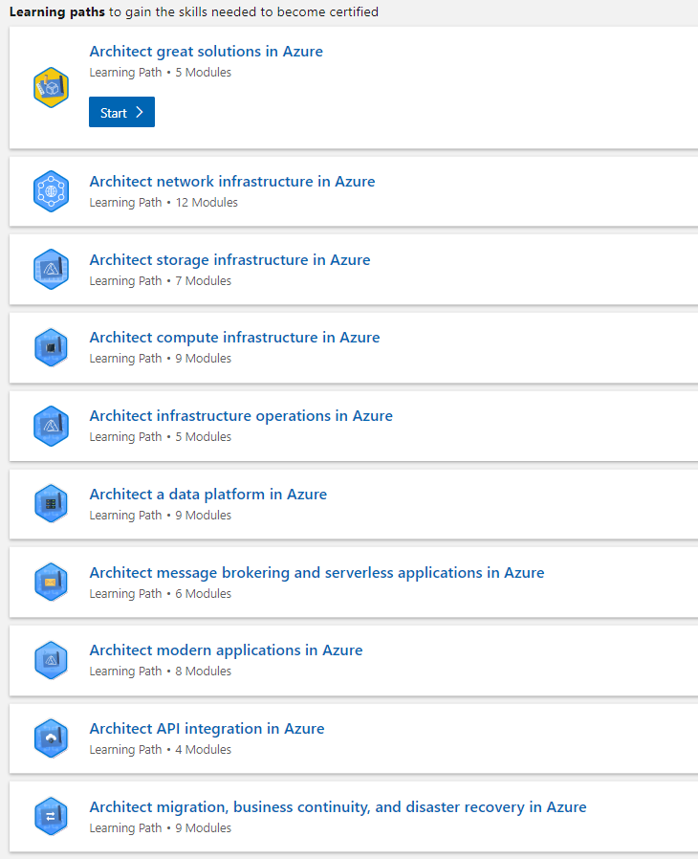
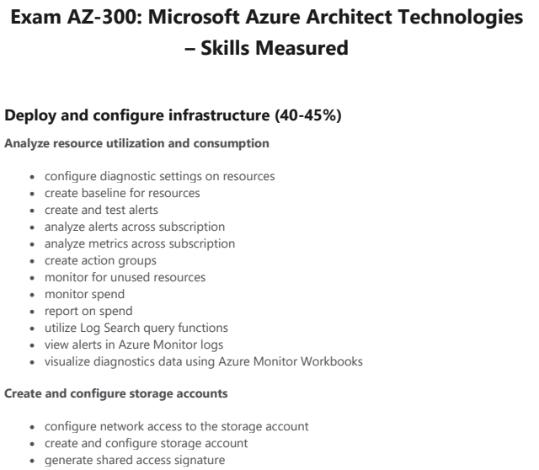
Each Test has Learn Modules and a Detailed Skills List
Part of Page 1 of 5

Slide 10
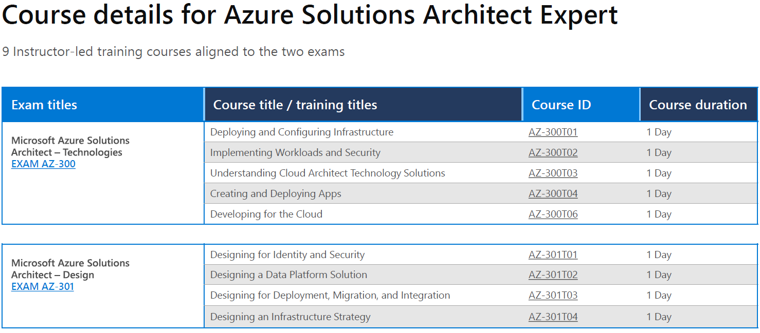
There are also Instructor-led Courses

Slide 11
Learning Resources
Free
Microsoft Learn (replaced and expanded Microsoft Virtual Academy)
Pluralsight (selected courses) – includes skill assessments and Role IQs (aggregating scores for related skills)
Not Free
Microsoft Instructor-led Courses (taught by MS Learning Partners)
Official Practice Exams from MeasureUp
Available for many (but not all) role-based certification tests
Wintellect Azure Certification Courses – https://j.mp/wintellect-cert-offer
Linux Academy (some free Azure content – registration required)
LinkedIn Learning (requires premium subscription)

Slide 12
Certification How-To

Slide 13
Demos
Microsoft Learn - https://docs.microsoft.com/en-us/learn/paths/architect-great-solutions-in-azure/
Pluralsight - https://app.pluralsight.com/library/
Practice Tests - https://www.measureup.com/

Slide 14
Q and A

Slide 15
Links
MS Learn - Certification Paths
(docs.microsoft.com/en-us/learn/certifications/)
FREE Pluralsight Resources for Azure (www.pluralsight.com/partners/microsoft/azure)
MS Guide to Training and Certification (85 pages)
(https://query.prod.cms.rt.microsoft.com/cms/api/am/binary/RWtQJJ)
Azure Fundamentals (AZ-900) Learning Resources
(aka.ms/AzureFundamentalsLearning)
Role-based Certifications Poster
(aka.ms/TrainCertPoster)
MS Instructor-led Course Catalog
(https://docs.microsoft.com/en-us/learn/certifications/courses/browse/)
Azure Docs

Slide 16
Docs

Slide 17
Contact Info
Eric Flamm
E-Mail: eric@flammconsulting.com
LinkedIn: https://www.linkedin.com/in/ericmflamm/
GitHub: https://github.com/eflamm
Twitter: @eflamm
Phone: 678-524-4256
Presentations Page: https://eflamm.github.io/presentations/

Slide 18
